Slide 1

Resilix AI — From Concept to Working Prototype
Round 2 Hackathon Evaluation · Team Benadryl

Slide 2
What We've Built So Far
GeoJSON Integration
Risk Data Processing
Interactive Map
Parsed risk_heatmap.geojson with node IDs, lat/long, water levels, and risk scores
Structured high-risk zones (node_186, node_105) vs. safe locations with categorized outputs
Next.js + Deck.gl + MapLibre GL running on ESRI Dark Canvas basemap
Risk Visualization
Telemetry Framework
Custom ScatterplotLayer — crimson (high), amber (moderate), emerald (safe)
Structured data objects + fallback/mock handlers for smooth rendering before live feeds connect

Slide 3




Who Is Resilix AI Built For?
Municipal Emergency Dispatchers
Disaster Response Teams
Emergency Command Centers
Must know which areas are becoming dangerous in real-time. Resilix provides geospatial risk visualization + prioritized hazards.
Require a centralized operational picture. Resilix combines infrastructure + environmental intelligence in one interactive dashboard.
Need rapid hazard visibility and safe response routes. Resilix delivers a unified risk map + incident intelligence at a glance.
Secondary expansion audience: city infrastructure managers, utility operators, and transit management teams.

Slide 4
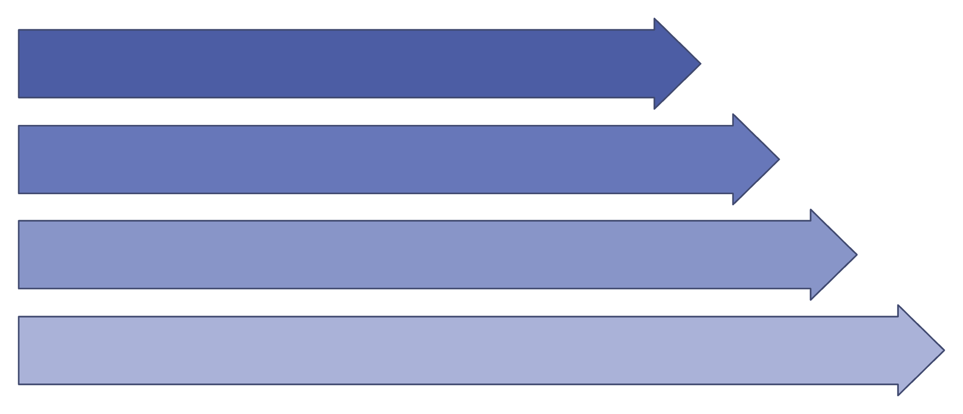
Every Disaster Creates a Chain of Decisions
Data
Intelligence
Understanding
From the moment severe weather hits, responders face a cascade of compounding decisions — with no unified system to guide them.
Action
The Problem Chain
Core Value
Severe weather → water/infrastructure stress → risk zones emerge → incident occurs → dispatcher must decide safe routes — with fragmented information at every step.
Risk detection alone isn't enough. Resilix connects hazard intelligence directly to emergency decision-making and response automation.

Slide 5
Inside the Working Prototype
Every component below is implemented and running in the current build.
1
2
Data Pipeline
Visualization Engine
risk_heatmap.geojson → GeoJSON parsing → structured risk data with lat/long, water levels, and node IDs
Deck.gl ScatterplotLayer + spatial risk polygons → color-coded risk states on a dark command-center interface
3
4
Map Foundation
Telemetry Layer
MapLibre GL + ESRI Dark Canvas basemap → clean, fast, emergency-ready cartographic interface
Structured telemetry objects + fallback/mock data handlers → smooth rendering before live feeds connect

Slide 6
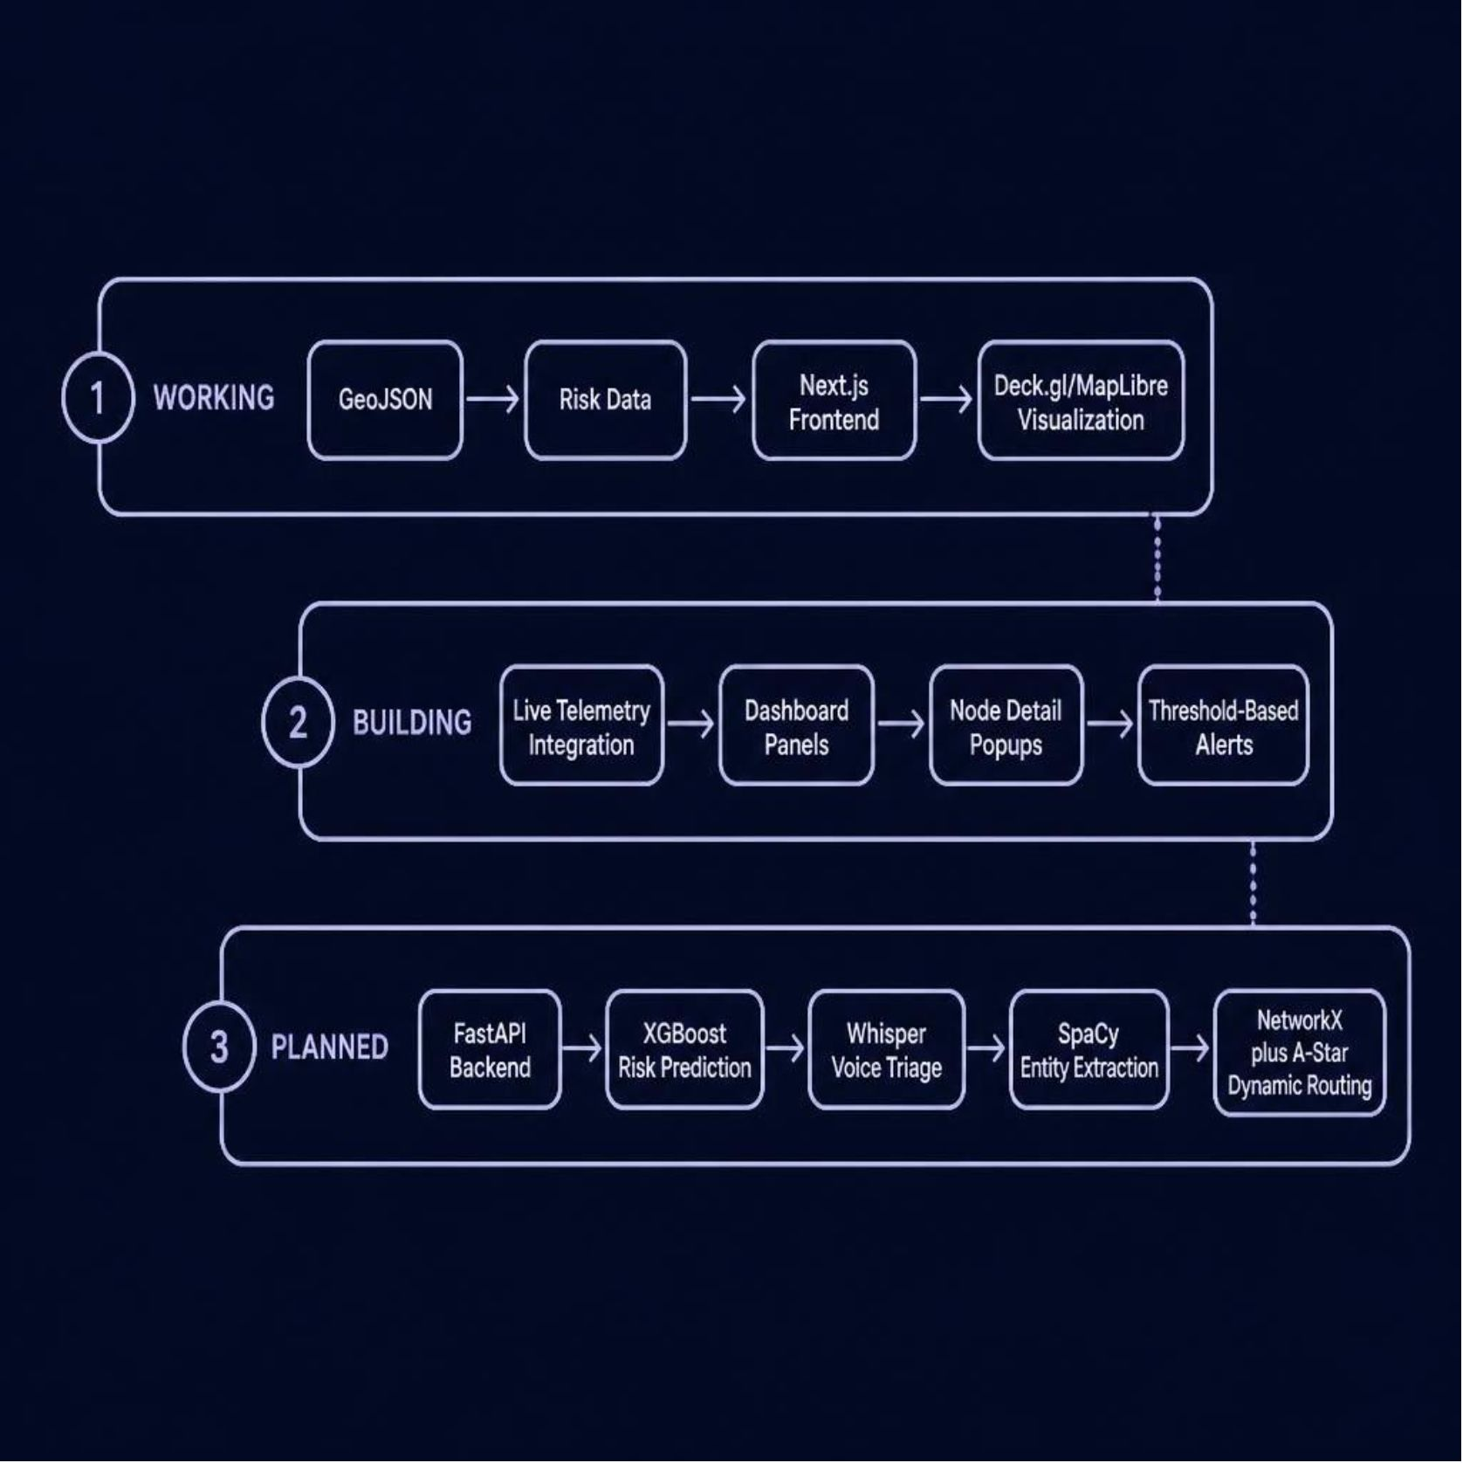
Technical Architecture: Current and Planned
✅ Currently Working
GeoJSON → Risk data → Next.js frontend → Deck.gl/MapLibre visualization. Fully operational in the prototype.
🔧 Currently Building
Live telemetry integration, dashboard panels, node detail popups, and threshold-based alerts.
📋 Planned Integration
FastAPI backend, XGBoost risk prediction, Whisper voice triage, SpaCy entity extraction, NetworkX + A* dynamic routing.
Data Sources
Synthetic telemetry, public weather APIs, OpenStreetMap — future live IoT feeds as platform matures.

Slide 7





Designed to Scale From One City to Many
Geographical
Single region → multiple cities → state/regional network → national urban disaster platform
Data
Mock telemetry → live feeds → weather + infrastructure + traffic + utilities
Technical
Modular Next.js + FastAPI → independent AI/routing engines → cloud containerization
Functional
Water/flood risk → electrical grid → voice triage → dynamic routing → additional hazard models

Slide 8

From Prototype to Deployable Platform
Phase 1 — COMPLETED
Phase 3 — NEXT
GeoJSON integration, risk processing, interactive map, risk visualization, telemetry framework
XGBoost prediction, Whisper voice triage, SpaCy NER, A* rerouting, full emergency workflow
1
2
3
4
Phase 2 — CURRENT
Phase 4 — SCALE
Live telemetry, dashboard panels, node history, automated alerts, UI refinement
Multi-city datasets, additional hazard models, expanded data feeds, deployment across urban systems
View our implementation: github.com/shauryasingla505/resilix · Team Benadryl — Hackathon Round 2 Evaluation

